Slide 1
JavaScript

Slide 2
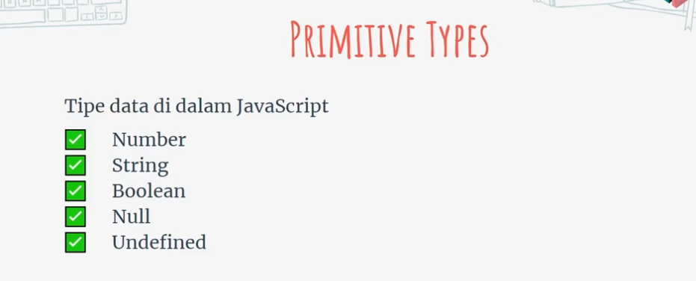

Slide 3


Slide 4
Variavel
Let
Const (value labele muda, value labele mamuk)

Slide 5
Concat in JS (+)
Template Literal `${variable_name}`
Matematika:
  Math.PI
  Math.abs(-123)

Slide 6
Console.log();
Console.warn();
Console.error();
Alert();
Promp();

Slide 7
Array
Push = Aumenta husi Kotuk
Pop = Hamos husi Kotuk
Shift = hasai husi oin
ushift = aumenta husi oin

Slide 8
Array
Concat = Junta array

